Slide 1
IUT Online Lecture Service
Sep 2020
Academic Affairs and Admissions Team

Slide 2
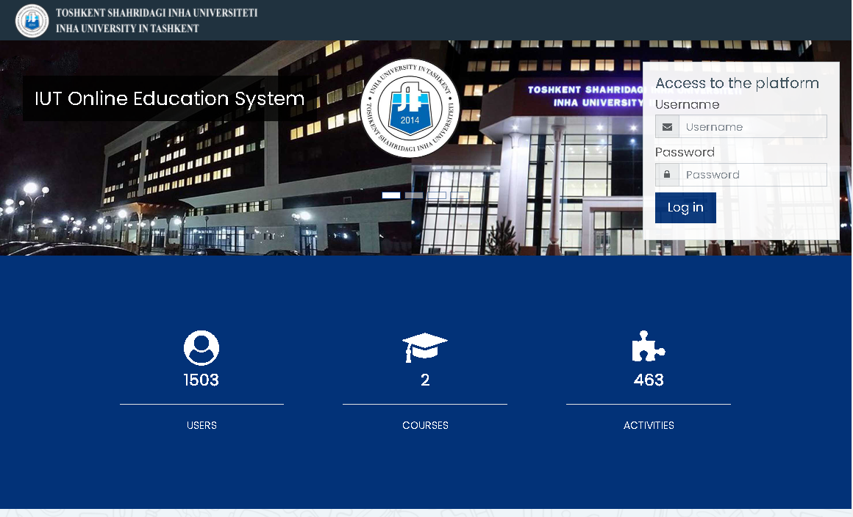
1. IUT Online Lecture : http://online.inha.uz
1. Input your ID and Password
2. Click "Log in"
* If it is your first time,
the default password is
Abc@12345
※ "A" is a capital letter

Slide 3
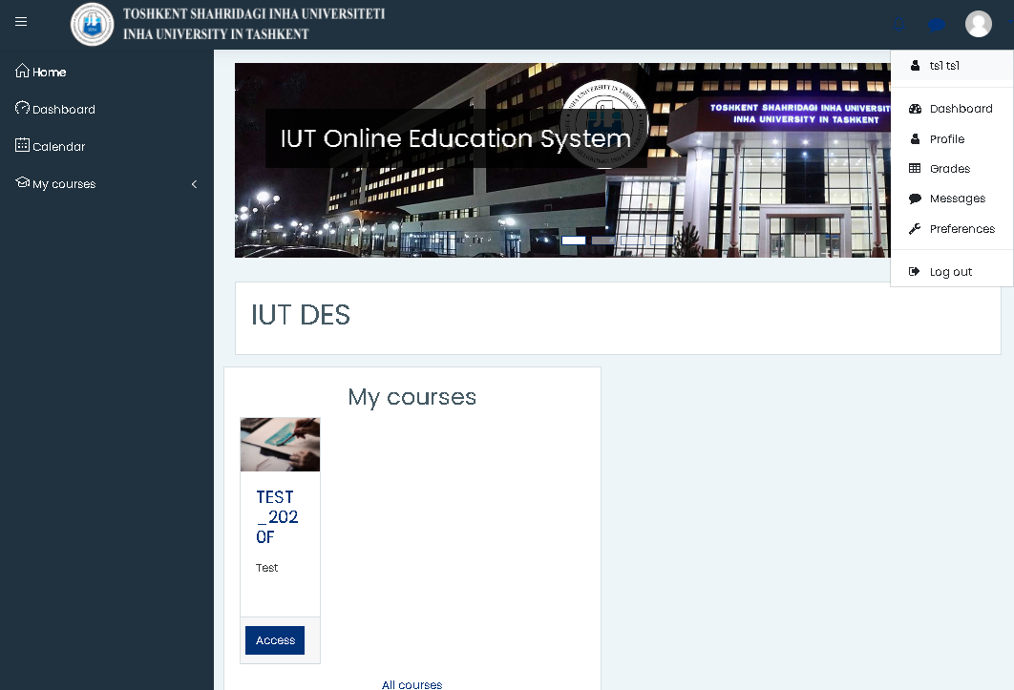
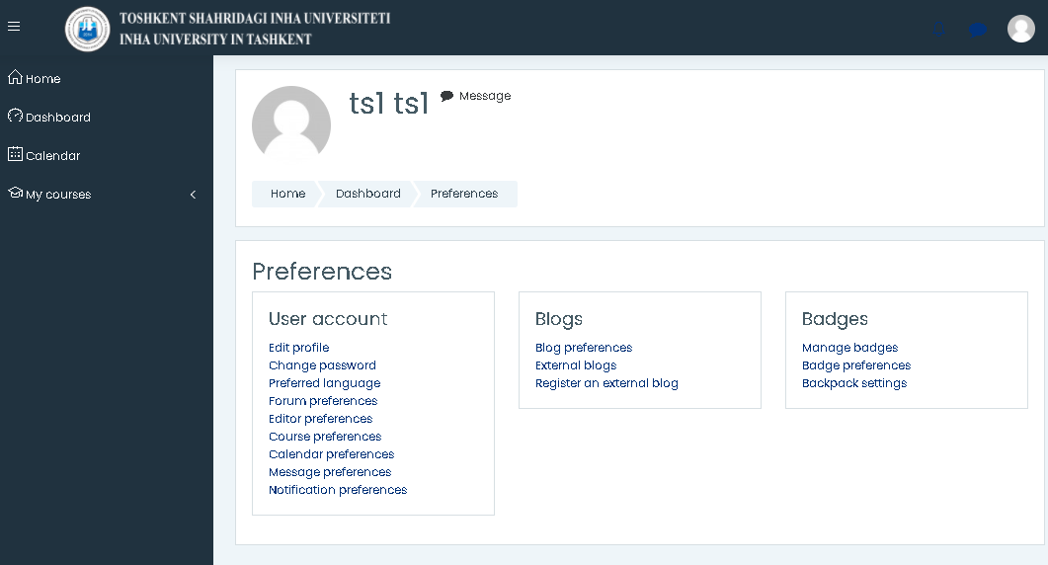
2. Change password(1/2)
1. Click this icon
2. Click "Preferences"
3. Click "Change password"

Slide 4
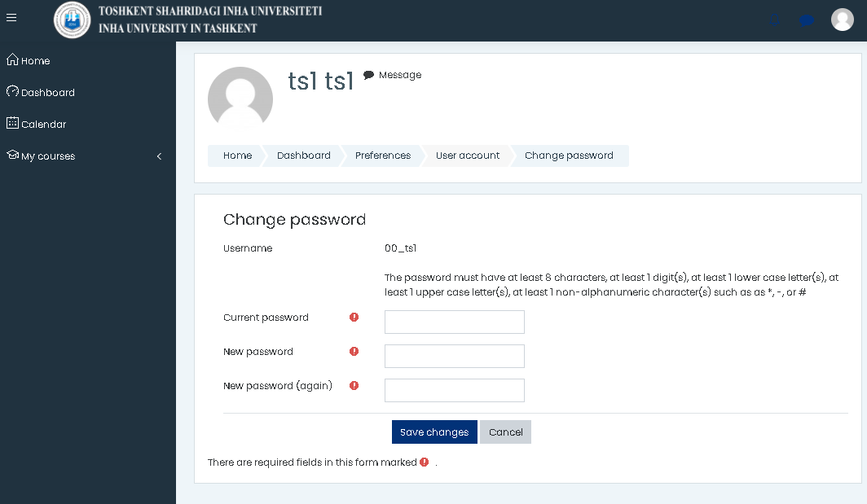
3. Change password(2/2)
1. Input your new password
2. Click "SAVE CHANGES"

Slide 5
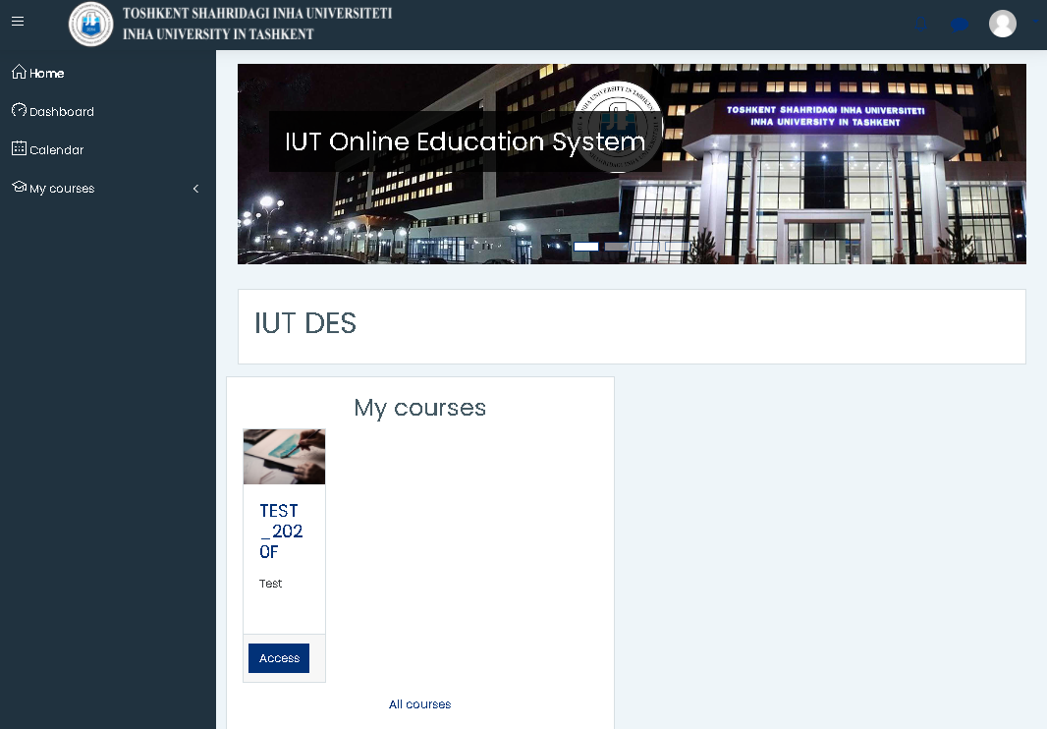
4. Main page
1. You can find
your courses.
2. Click your course

Slide 6
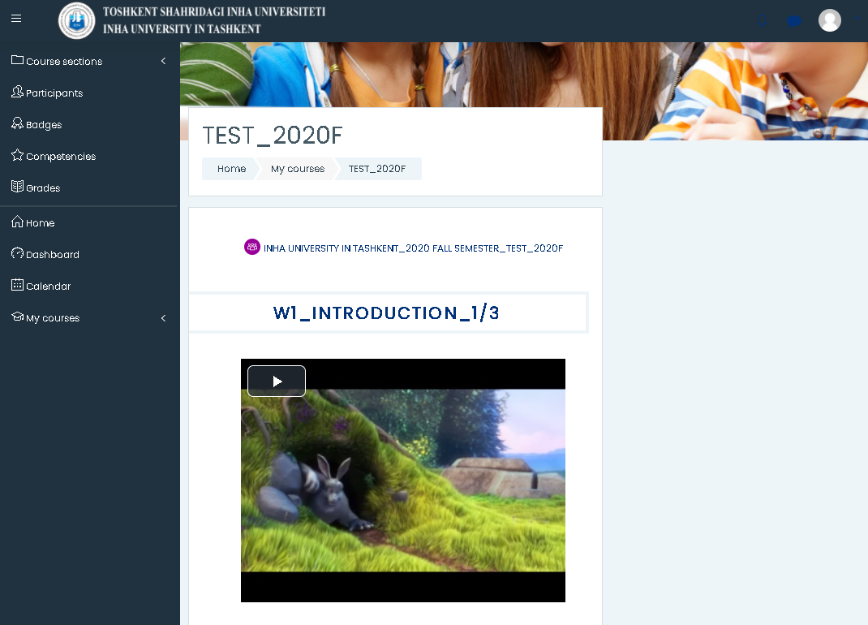
5. Watching Lecture Video
You can find the announcement/notice here
Click this icon and watch lecture video

Slide 7
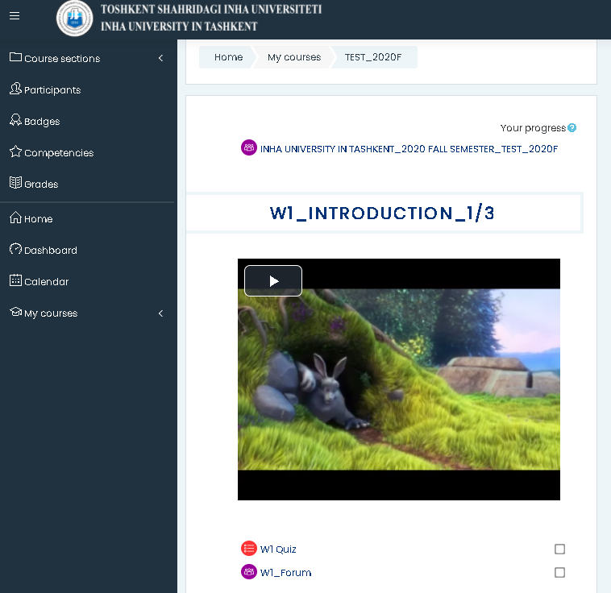
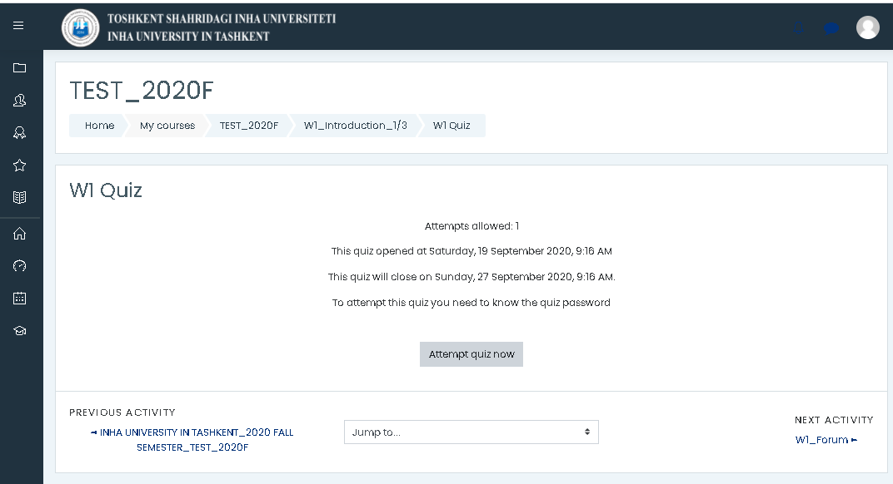
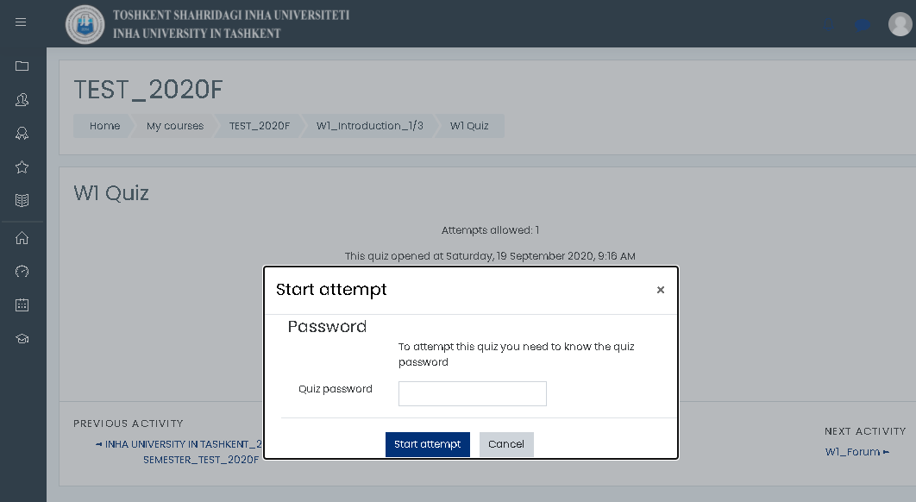
6. Quiz(1/2)
2. Click "Attempt quiz now"
1. Click "W1 Quiz"
3. Enter password
* Professors may set
password for the quiz

Slide 8
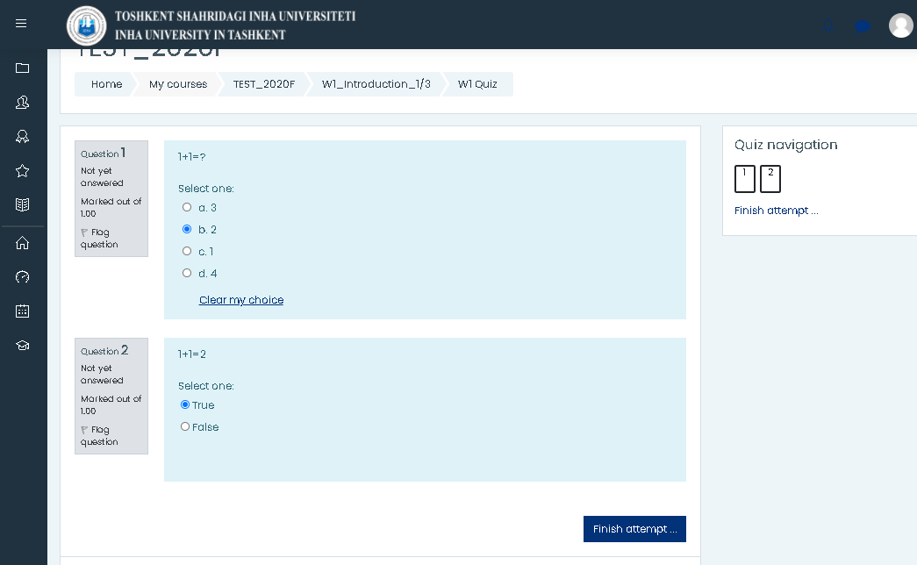
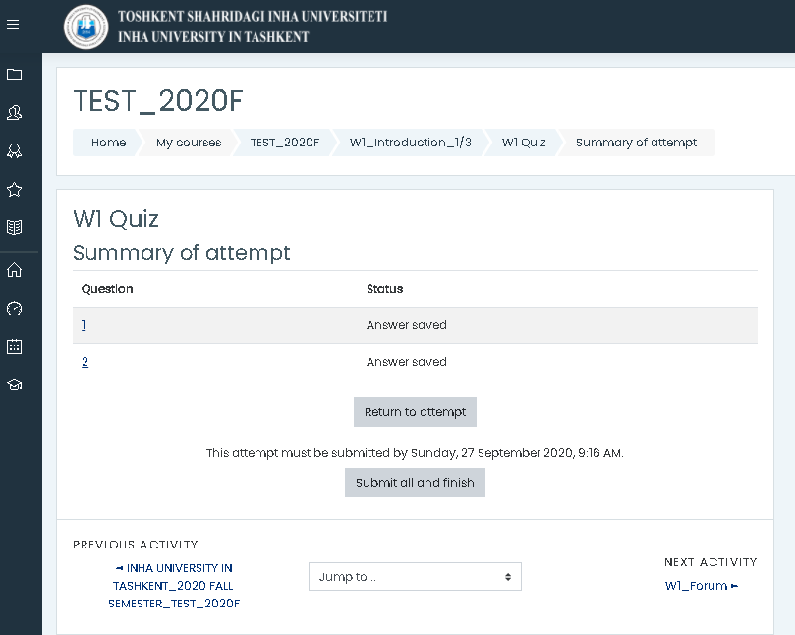
6. QUIZ(2/2)
1. Solve the problems
and check answers
2. Click "Finish attempt"
3. Click "Submit all and finish"

Slide 9
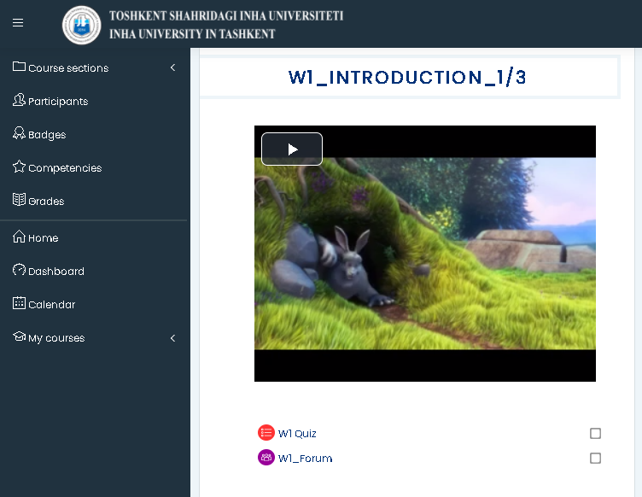

7. Forum
2. Read the
Forum subject.
1. Click "W1 Forum"
3. Click
"Reply"
4. Type your opinion and click the Submit button

Slide 10
THANK YOU

